Slide 1
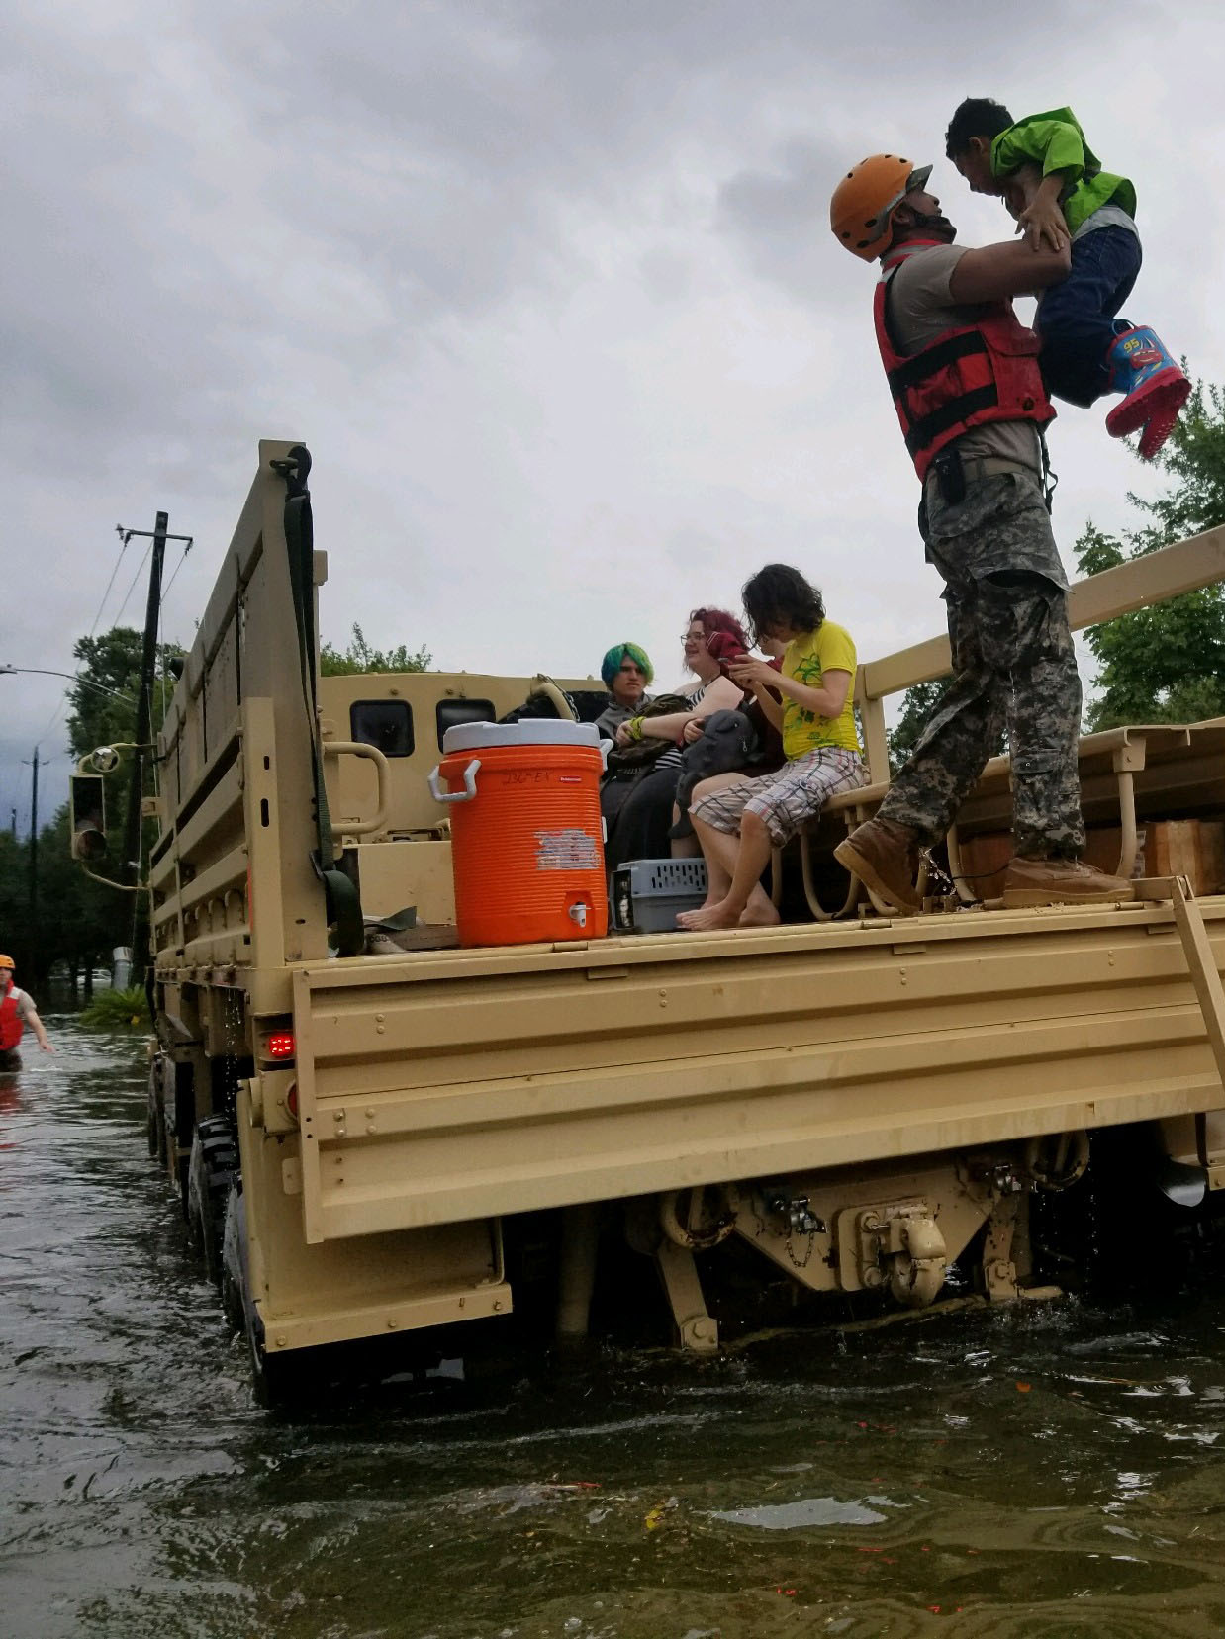
Neighborhood Analysis
Sea Level Rise & the U.S. coast
© Environmental Defense Fund

Slide 2
Objective
This is a demographic study to understand how vulnerable different states are to climate-induced disasters such as sea level rise (SLR), storm surges, and hurricanes.
Five Cases: Three states in the contiguous United States (Florida, Louisiana & Texas) are studied along with the island of Hawaii and the U.S. territory of Puerto Rico.
A comparative analysis can potentially provide policy recommendations for long-term investments in communities to build their capacity for climate resilience.

Slide 3
Your best quote that reflects your Methodology… “It’s one small step for man, one giant leap for mankind.”
The level of analysis is justified.
The level of analysis is by county; however, the data is represented collectively by state.
SLR modeling is used to select counties which would be affected by sea level rise using NASA data.
Place profile analysis of selected counties using IPUMS/Census data.
Opportunity mapping of selected counties using EPA EJSCREEN data.
Comparison of results and assessment of locations for potential investment possibilities.
Methodology
Place Profile
Opportunity Mapping
Conclusion

Slide 4
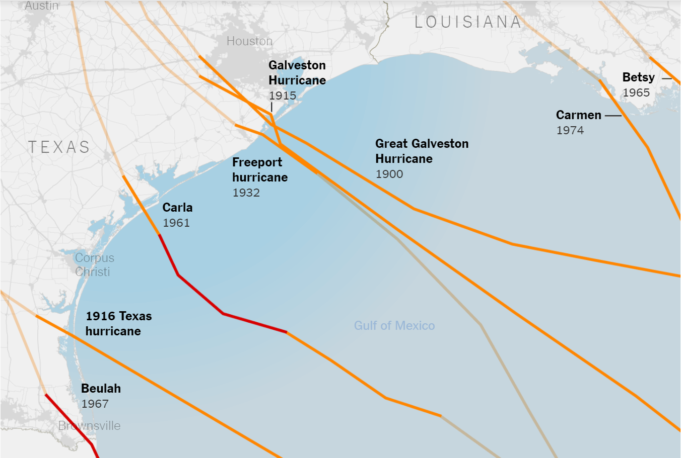
Level of Analysis
What scale is optimal for this analysis?
State?
Census Tract?
County?
© NYT

Slide 5
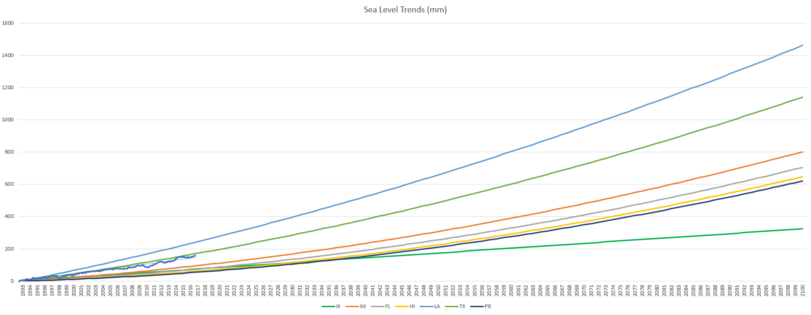
Sea Level Rise Modelling
1500 mm/5 ft (2100)
600 mm/3 ft (2045)
SLR is predicted up to the year 2100 for the five cases as well as two baseline scenarios.
The model is based on observed trends from 1993 to 2017 as observed by NASA’s altimetry satellites JASON and TOPEX/Poseidon
Methodology
Place Profile
Opportunity Mapping

Slide 6
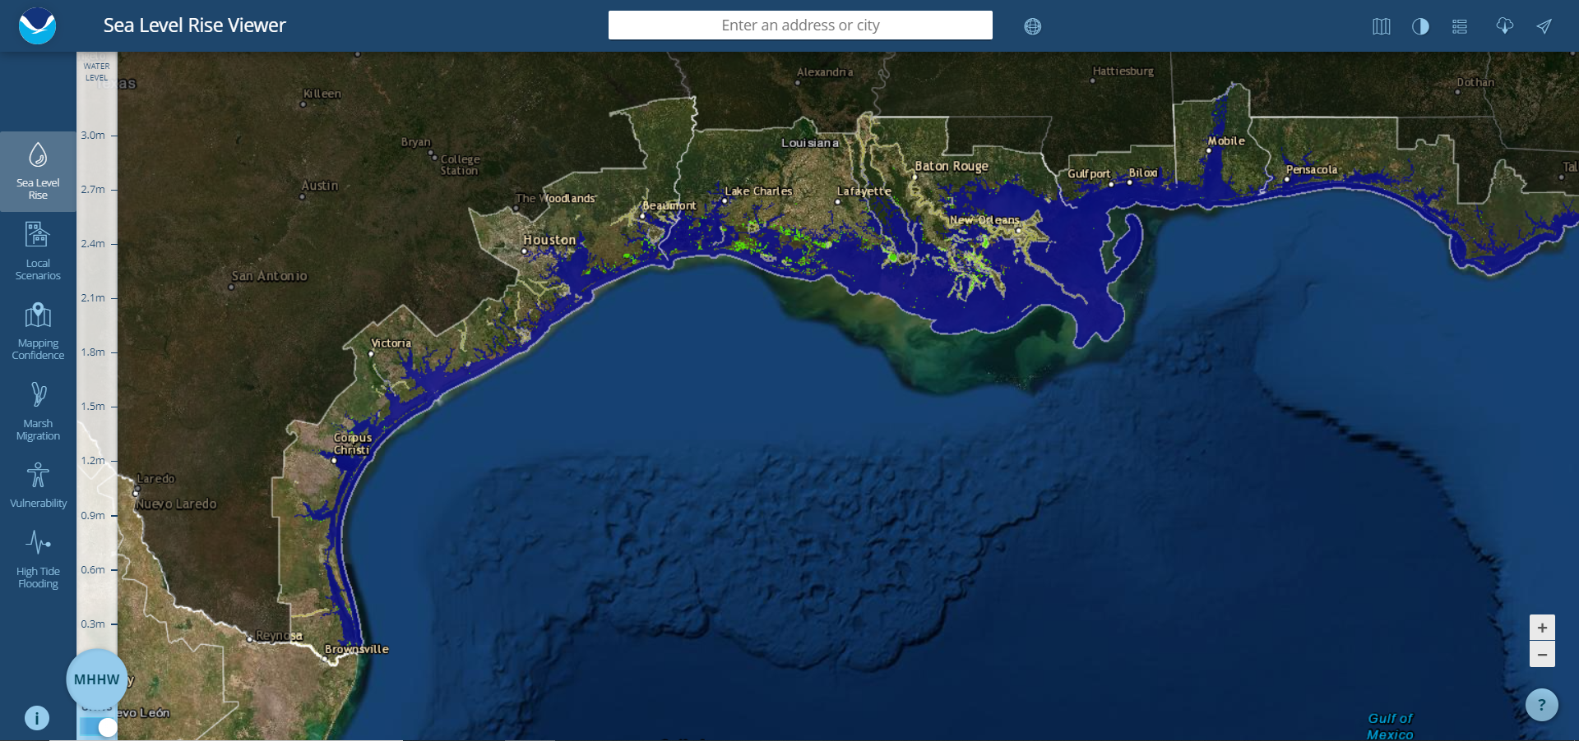
Methodology
Place Profile
Opportunity Mapping
Conclusion

Slide 7
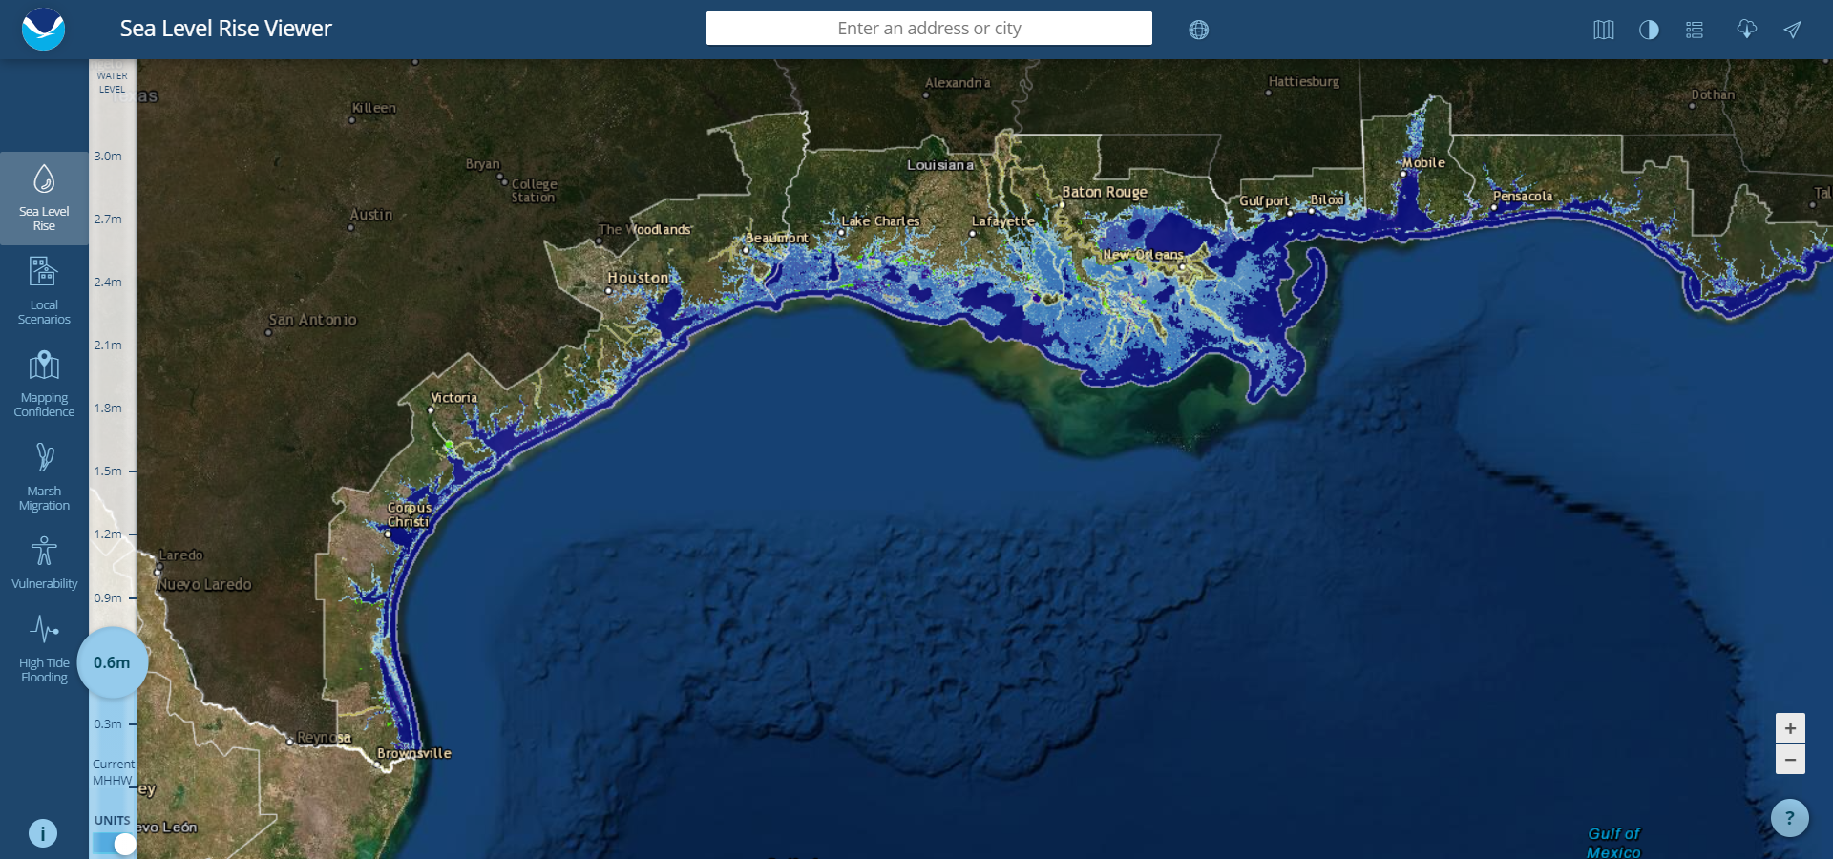
Methodology
Place Profile
Opportunity Mapping
Conclusion

Slide 8
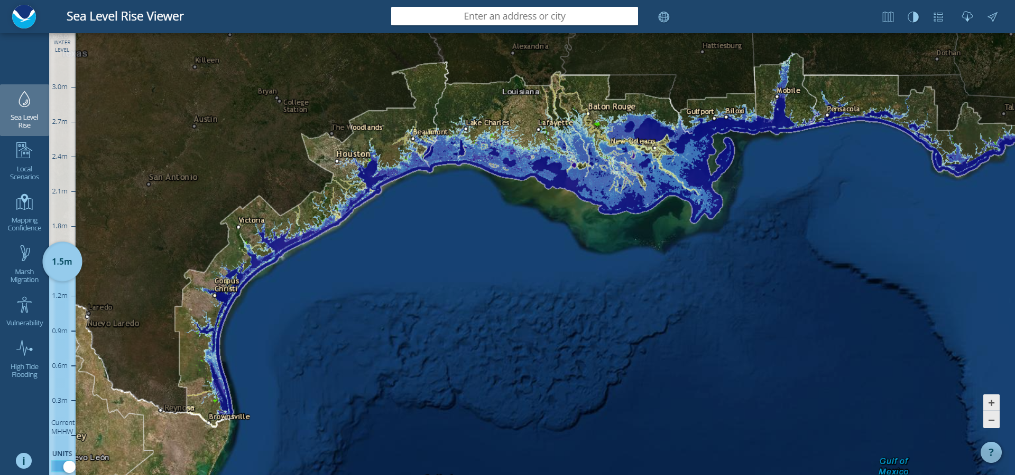
Methodology
Place Profile
Opportunity Mapping
Conclusion

Slide 9
Place Profile
The Place Profile is created to get a sense of the demographics for the five cases. This data is oriented to be utilized in future projects which aim to assess vulnerabilities.
Some of the indicators that were considered are:
Population Densities
Poverty Levels
Race & Ethnicity
Age & Sex
Methodology
Place Profile
Opportunity Mapping

Slide 10
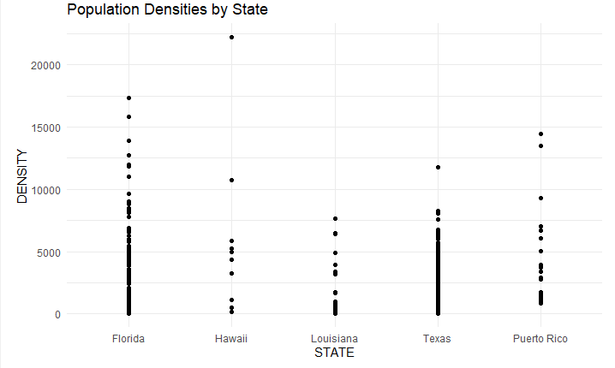
Population Densities
Densities in regions across the larger states of FL and TX are clustered under 10,000 per PUMA (Public Use Microdata Area).
Some areas in FL report higher average densities going up to 17,000.
Honolulu appears to house a significant population of Hawaiians.

Slide 11
Poverty Levels
43% of people for Puerto Rico living below the poverty line in 2018.
The highest proportion of the population living below the poverty line is aged 18 to 59 years consistently across all the states.
A significant number of the impoverished population in Texas comprises of teenagers.

Slide 12
Opportunity Mapping
For opportunity mapping, environmental indexes are plotted for each county in the states being studied.
The indicators are obtained from the EPA EJSCREEN, and they are:
National Scale Air Toxics Assessment Air Toxics Cancer Risk
National Scale Air Toxics Assessment Respiratory Hazard Index
National Scale Air Toxics Assessment Diesel PM (DPM)
Particulate Matter (PM2.5)
Traffic Proximity and Volume
Diesel Particulate Matter (DSLPM)
Methodology
Place Profile
Opportunity Mapping

Slide 13
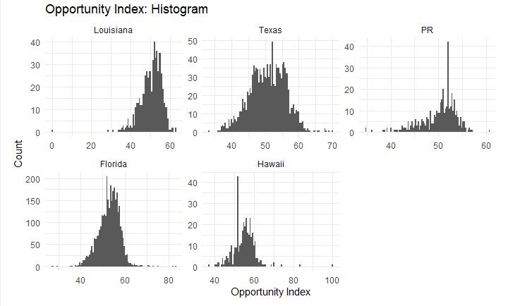
Opportunity Index
Counties/Municipalities in Puerto Rico and Texas have the highest spread of opportunity.
Hawaii appears to have a tighter spread across its counties.
The opportunity indexes are not disparate across the five cases.

Slide 14
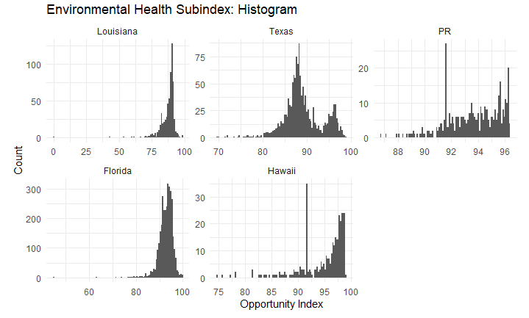
Environmental Index
Puerto Rico and Hawaii have similar environmental health subindexes.
Counties in Texas are spread across 80 to 100 on the ENV scale.

Slide 15
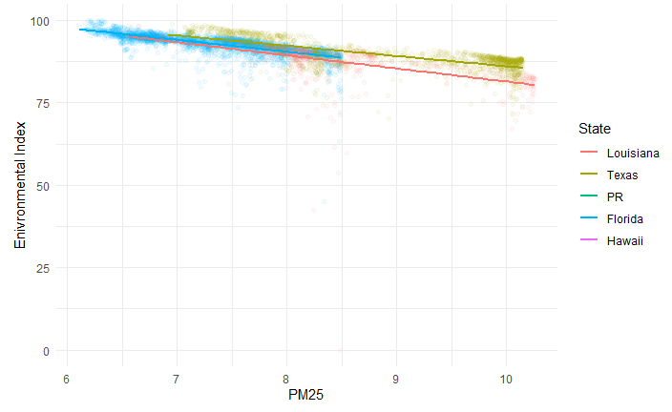
ENV – PM25
Higher levels of PM25 affect Louisiana and Texas more detrimentally.
Hawaii and Florida fares better overall with respect to the environmental index.

Slide 16
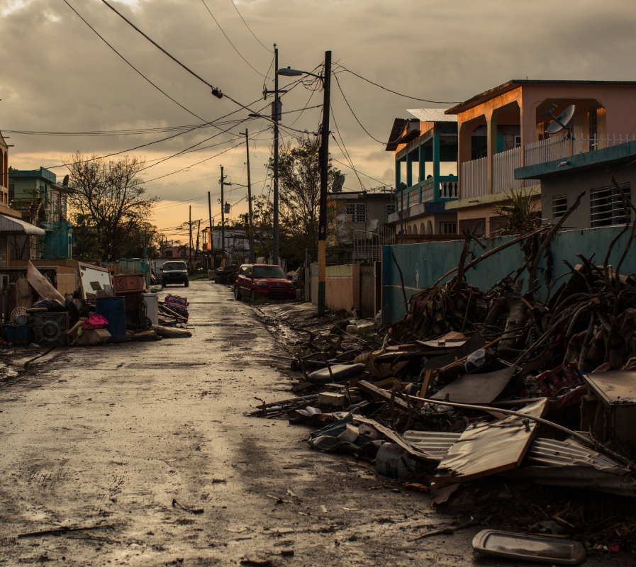
Key Takeaways
Place profiling helps us understand the demographic mix and economic status of the communities. Opportunity mapping will help guide investments to communities where it is needed most.
The combined analysis of place profile and opportunity zone mapping helps us understand how vulnerable certain communities are compared to others.
Investment can be directed towards programs boosting community resilience, coastal zone property buy-outs, social capital building, and infrastructure development such as hard and soft coastal engineering measures.
© Rolling Stone Magazine

